Slide 1
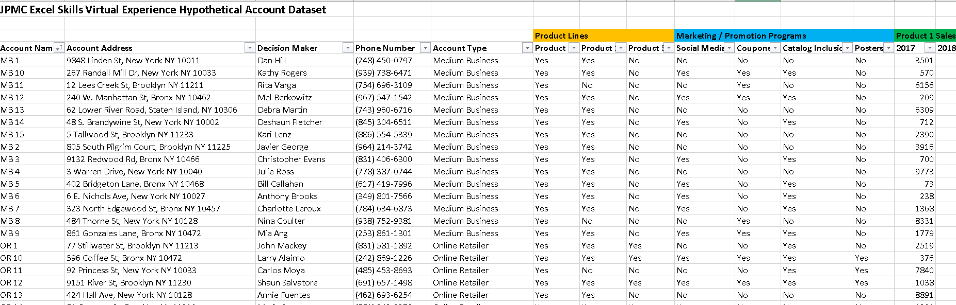


Data-Driven Storytelling Presentation: J.P.Morgan Company Virtual Internship
Given Dataset by Client

Slide 2
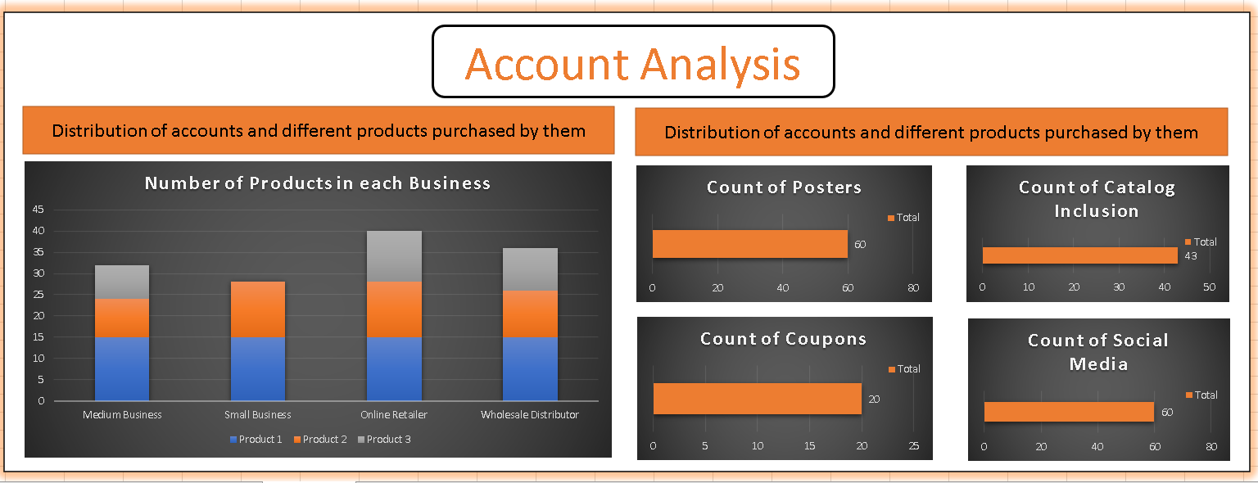
Account Details
In this we can see the numbers of products in each business, as we can see clearly product 1 is in every business whereas product 3 in not been used by small Business. Therefor, we can more focus on product 1 sales in different business market.

Slide 3
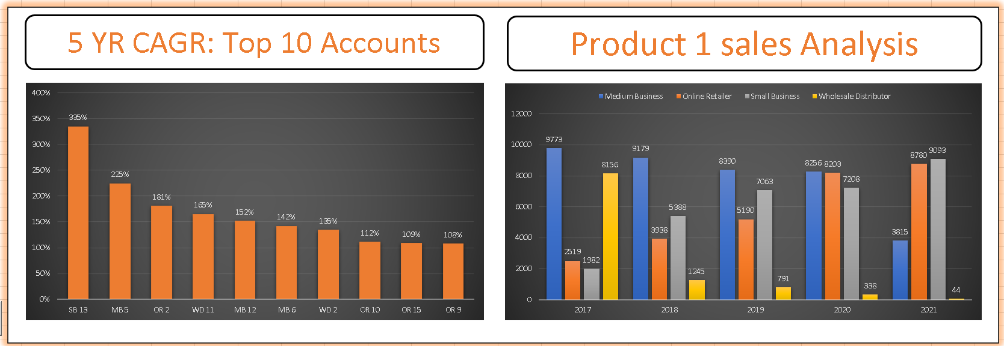
As I already shown you product 1 progress in every business market, here are some more detailed progress report of product 1 from it’s production year 2017. We can compare sales in different market and from analysis we can see in medium and wholesales business sale is decreasing continuously whereas in Online Retailer and Small business product 1’s sales are increasing. Therefor with this your company should more focus on this these medium and wholesales business to grow more.

Slide 4

Summary
Thank You

